Slide 1
IoT at the Edge with .NET and Meadow
Adrian Stevens
Notes:
Hello everyone, and welcome to today's session on iot at the edge with Meadow and .NET.' My name is Adrian Stevens, and I'm thrilled to have the opportunity to speak with you today.
As many of you know, artificial intelligence has been advancing at an incredible pace, transforming industries and the way we interact with technology. Simultaneously, edge computing has emerged as a critical component in the Internet of Things (IoT), allowing devices to process data locally rather than relying solely on cloud services.
Today, we'll explore how these two powerful technologies intersect. Specifically, we'll delve into implementing TensorFlow Lite for Microcontrollers on the Meadow F7 platform using .NET. We'll also take a look at some innovative AI sensors from companies like Useful Sensors, such as the Tiny Code Reader and Person Sensor, which offer plug-and-play AI functionalities.
By the end of this session, you'll have a deeper understanding of how to harness these tools to create intelligent, efficient, and responsive edge devices. So, let's dive in!"

Slide 2
AI at the Edge
Meadow
Agenda
Smart Sensors
TensorFlow on Microcontrollers
Choosing the right Hardware

Slide 3



The Growing Importance of Edge AI
Why AI at the Edge Matters
Notes:
Edge AI plays a critically important role in modern IoT workflows and is experiencing exponential growth. Devices at the edge are not just passive data collectors anymore; they're actively processing and making decisions based on that data.
One key reason for this shift is the need for immediate data processing and real-time decision-making. Applications like autonomous vehicles, industrial automation, and smart homes require instant responses that cloud-based solutions can't always provide due to latency issues.
Moreover, relying solely on the cloud poses challenges such as bandwidth limitations, higher costs, and dependency on a stable internet connection. By moving AI processing to the edge, we can overcome these challenges, leading to more robust and efficient systems.
In essence, AI at the edge enables devices to be smarter and more responsive, unlocking new possibilities for innovation across various industries.

Slide 4



Benefits of Running AI at the Edge
Latency and resiliency
Bandwidth
Cost
Notes:
So, what are the specific benefits of running AI at the edge rather than in the cloud? Let's explore a few key advantages.
First, lower latency. By executing AI models locally on edge devices, we achieve immediate processing of data. This is crucial for applications where every millisecond counts, such as emergency response systems or high-speed manufacturing lines.
Second, reduced bandwidth cost. Processing data on the device means we don't have to send large amounts of raw data over the network to the cloud. This not only saves on data transmission costs but also alleviates the burden on network infrastructure, which can be particularly beneficial in areas with limited connectivity.
Third, reduced total cost of ownership (TCO). Utilizing the processing capabilities of edge devices can lower server loads and operational costs. By offloading tasks from centralized cloud servers to distributed edge devices, organizations can achieve significant cost savings.
For example, consider a smart surveillance system that uses cameras to monitor for security threats. If the system can process video feeds locally to detect anomalies or recognize faces, it can respond more quickly to incidents and reduce the need to stream high-definition video continuously to the cloud.
Additionally, if these are mission-critical workflows, edge AI reduces the risk of failure if a network connection goes down.
These benefits collectively enhance the performance and efficiency of IoT systems, making AI at the edge a compelling approach for many applications.

Slide 5
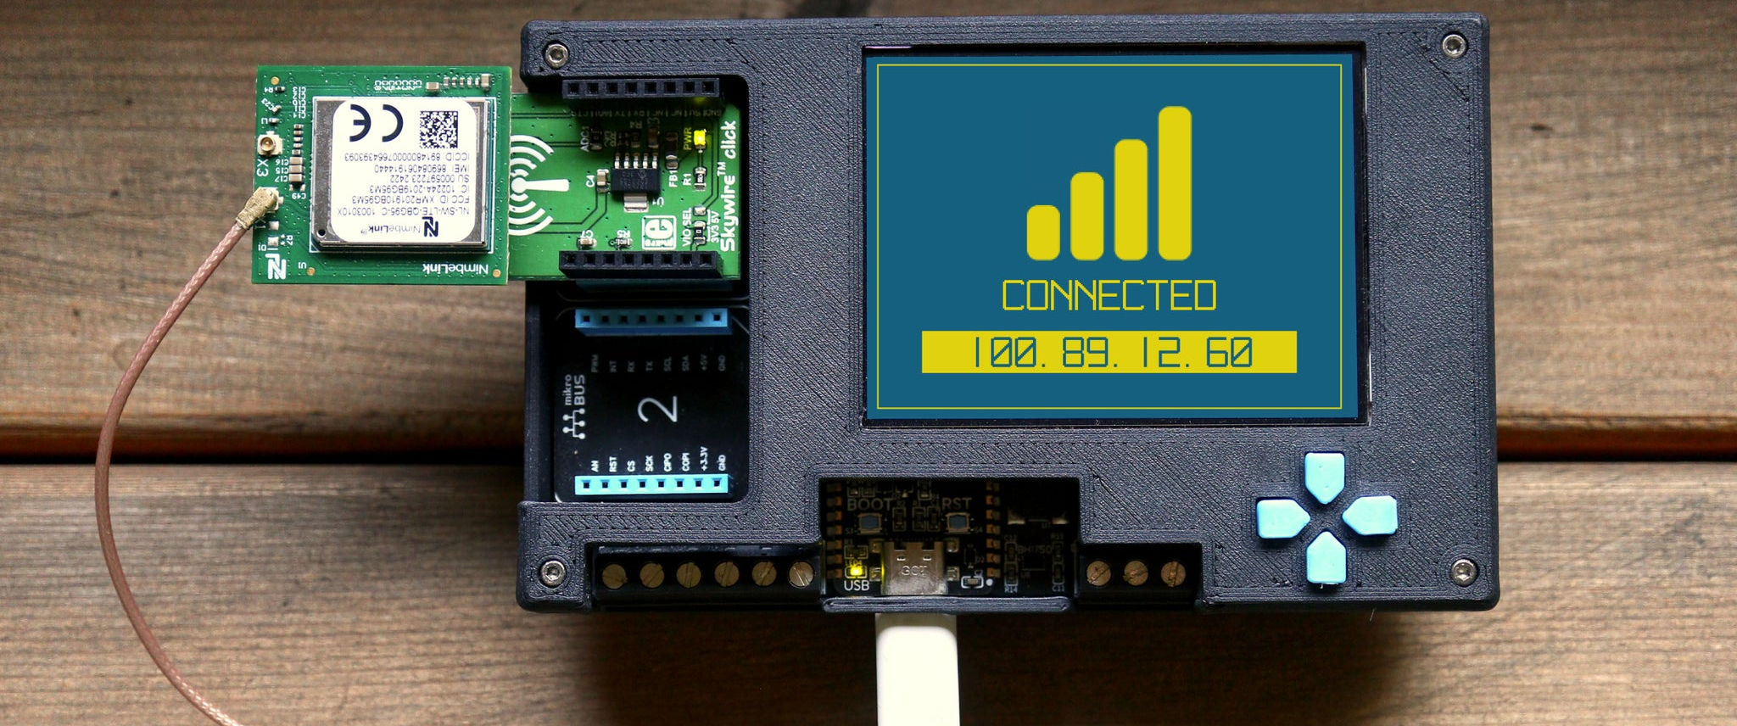
Introducing Meadow F7 for Edge AI
Notes:
Now that we've discussed the importance of AI at the edge, let's introduce the tools that make it possible: the Meadow F7 microcontroller and .NET.
The Meadow F7 is a powerful and versatile microcontroller platform designed for IoT applications. It features a high-performance STM32F7 processor, ample memory, and a rich set of I/O capabilities, making it well-suited for running complex tasks at the edge.
One of the standout features of the Meadow F7 is its support for .NET, allowing developers to write applications in a familiar language with a vast ecosystem of libraries and tools. This means you can leverage your existing C# skills to develop for the IoT space.
By combining the Meadow F7's hardware capabilities with the productivity of .NET, we have a platform that's ideal for implementing AI at the edge. It bridges the gap between high-level application development and low-level hardware interaction, enabling rapid development of intelligent edge devices."

Slide 6
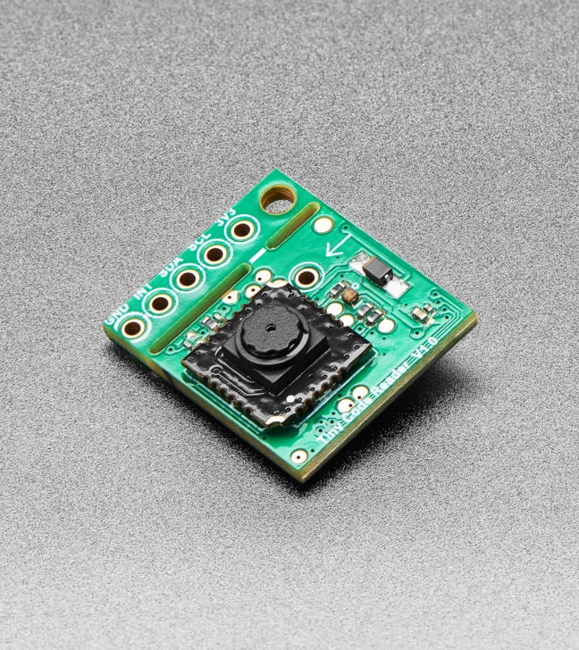
Plug-and-Play AI
AI Sensors from Useful Sensors
Notes:
While implementing AI models directly on microcontrollers is powerful, sometimes we need a quicker or more specialized solution. That's where companies like Useful Sensors come in.
Useful Sensors provides plug-and-play AI sensors that offer specific AI functionalities out of the box. Two notable products are the Tiny Code Reader and the Person Sensor.
The Tiny Code Reader is a small module that can read QR codes and other types of barcodes. It's designed to be easily integrated into projects that require quick and reliable code scanning without the need for complex setup or processing.
The Person Sensor is a module that detects the presence of people. It can identify if a person is in front of the sensor, count the number of people, and even estimate their proximity.
These sensors handle the AI processing internally and provide simple outputs that can be read by microcontrollers like the Meadow F7. This makes it incredibly easy to add sophisticated AI capabilities to your projects without diving deep into machine learning algorithms.
No training
No deploying
No runtime
It’s just there

Slide 7

Simplifying Hardware Integration
Open-source .NET driver library
Notes:
To make it even easier to work with these sensors and other hardware, we have Meadow.Foundation.
Meadow.Foundation is a comprehensive library of drivers and libraries for a wide range of sensors, displays, and other peripherals. It provides:
High-level APIs: Simplifying interaction with hardware components.
Consistent interfaces: Making it easier to swap out or add new devices.
Extensive documentation and examples: Helping you get up and running quickly.
For the Useful Sensors devices we've just seen, Meadow.Foundation includes drivers that allow us to integrate them into our projects with minimal code. This code sets up the sensor and defines an event handler for when a person is detected. Meadow.Foundation handles the low-level communication, so you can focus on your application logic.

Slide 8

Demo: Tiny Code Reader
From Useful Sensors
Notes:
Next, let's demonstrate the Tiny Code Reader.
[Display the Tiny Code Reader connected to the Meadow F7]
In this setup, the Tiny Code Reader is connected to the Meadow device. It's designed to scan and decode QR codes and other barcodes.
[Hold up a QR code in front of the sensor]
As I present this QR code to the sensor, it reads the code and sends the decoded information to the Meadow microcontroller. The device can then use this information for various purposes, such as:
Inventory management: Scanning products in a warehouse.
Access control: Verifying IDs or tickets.
Automation systems: Triggering actions based on specific codes.
Again, the advantage here is the simplicity of adding complex functionality to our projects. The sensor handles all the heavy lifting, and we can focus on how to utilize the data in our applications.

Slide 9

Introduction to TensorFlow
Train and run machine learning models
Notes:
Before we delve into TensorFlow Lite for Microcontrollers, I'd like to introduce you to TensorFlow itself.
TensorFlow is a free and open-source machine learning library developed by Google. It has become one of the most popular frameworks for building and deploying machine learning models, thanks to its powerful capabilities and supportive community.
TensorFlow makes implementing various machine learning algorithms much easier by providing:
A Comprehensive Ecosystem: It includes tools, libraries, and community resources that allow researchers and developers to push the state-of-the-art in machine learning and easily build and deploy ML-powered applications.
Flexibility: TensorFlow supports a wide range of tasks, from training models for image recognition, natural language processing, and time-series analysis, to deploying models in production environments.
Cross-Platform Support: You can run TensorFlow on CPUs, GPUs, and TPUs, and it supports multiple languages like Python, C++, and JavaScript, making it versatile for different development needs.
High-Level APIs: With APIs like Keras built-in, TensorFlow makes it simpler to construct and train neural networks without needing to manage the complexities of underlying algorithms.
In essence, TensorFlow empowers developers and researchers to:
Prototype Quickly: Experiment with new ideas and models rapidly.
Scale Easily: Move from research to production without rewriting code.
Deploy Anywhere: Run models on servers, in the cloud, on mobile devices, and even at the edge.
TensorFLow is a free an open-source library that makes implementing various machine algorithms much easier
A subset of the tensorflow reposity intended to run on embedded devices
And a small piece of that subset is meant for microcontrollers

Slide 10

LiteRT for Microcontrollers
Bringing TensorFlow Machine Learning to MCUs
Notes:
However, traditional TensorFlow is designed for powerful processors with ample memory and computational resources. This brings us to a challenge: How can we leverage the power of TensorFlow on resource-constrained devices like microcontrollers?
That's where TensorFlow LiteRT comes into play, specifically LiteRT for Microcontrollers. It's a version of TensorFlow optimized to run machine learning models on devices with limited resources.
It allows us to execute pre-trained machine learning models on devices with minimal memory and processing power.
However, it's important to note that due to hardware constraints, not all models can run on microcontrollers as-is. Models often need to be optimized and quantized to reduce their size and computational requirements.

Slide 11

Meadow.TensorFlow
Bringing Machine Learning to MCUs
Notes:
What is Meadow.TensorFlow for Microcontrollers?
Meadow.TensorFlow for Microcontrollers is an integration of TensorFlow LiteRT for Microcontrollers into the Meadow platform, specially for the Meadow F7…enabling us to run optimized AI models on Meadow.
… And This is the only .NET API for running LiteRT

Slide 12
Using Meadow.TensorFlow
A modern .NET API for LiteRT
public override Task Initialize()
{
gestureModel = new GestureModel(GestureModelData.Data);
}
private void OnAccelerometerUpdated(...)
{
gestureModel.Inputs.SetData(inputData);
var output = gestureModel.Predict();
for (int i = 0; i < gestureList.Length; i++)
{
var tensorData = output[i];
if (tensorData > 0.85)
//do work here
}
}
Notes:
See ! It’s .NET

Slide 13



Running TensorFlow on Meadow
Install Meadow TensorFlow
Load TFLite model
Infer results from live data
Notes:
Let's walk through how to implement TensorFlow Lite on the Meadow F7 using .NET
.
First, we'll add the Meadow TensorFlow Lite NuGet package to our Meadow project. This package provides the necessary libraries to run TensorFlow Lite models on our device.
Second, we'll load our pre-trained model into the application. This involves including the model file in our project and using the TensorFlow Lite API to load it at runtime.
Third, we'll prepare the input data for the model. This could be sensor readings, image data, or any other data that the model expects.
Fourth, we'll execute the model with the input data and collect the output results.
Finally, we'll interpret the results and use them to make decisions or trigger actions within our application.

Slide 14
Demo: Hello TensorFlow
AI on a Microcontroller with .NET
Notes:
Let's walk through a high-level demonstration of the AI workflow from data collection to model deployment.
Data Preparation:
Use a notebook or data processing tool to collect and preprocess your training data.
Label your data appropriately for supervised learning tasks.
Model Training:
Train your model using a framework like TensorFlow.
Adjust hyperparameters and validate the model's performance.
Model Optimization:
Optimize the model for edge deployment:
Quantization: Reduce model size and improve inference speed.
Pruning: Remove unnecessary weights to streamline the model.
Model Export:
Export the model in a format compatible with TensorFlow Lite, such as a .tflite file.
Deployment:
Include the model file in your Meadow project.
Use the TensorFlow Lite API to load and execute the model on your device.
Demonstration:
Show a simple application where the device makes predictions based on sensor input.
Highlight how the model's output is used within the application.
This workflow illustrates the end-to-end process of developing an AI application for edge devices using Meadow and .NET.

Slide 15
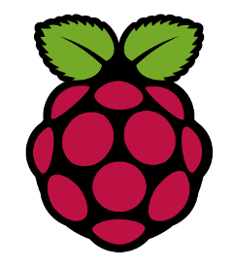
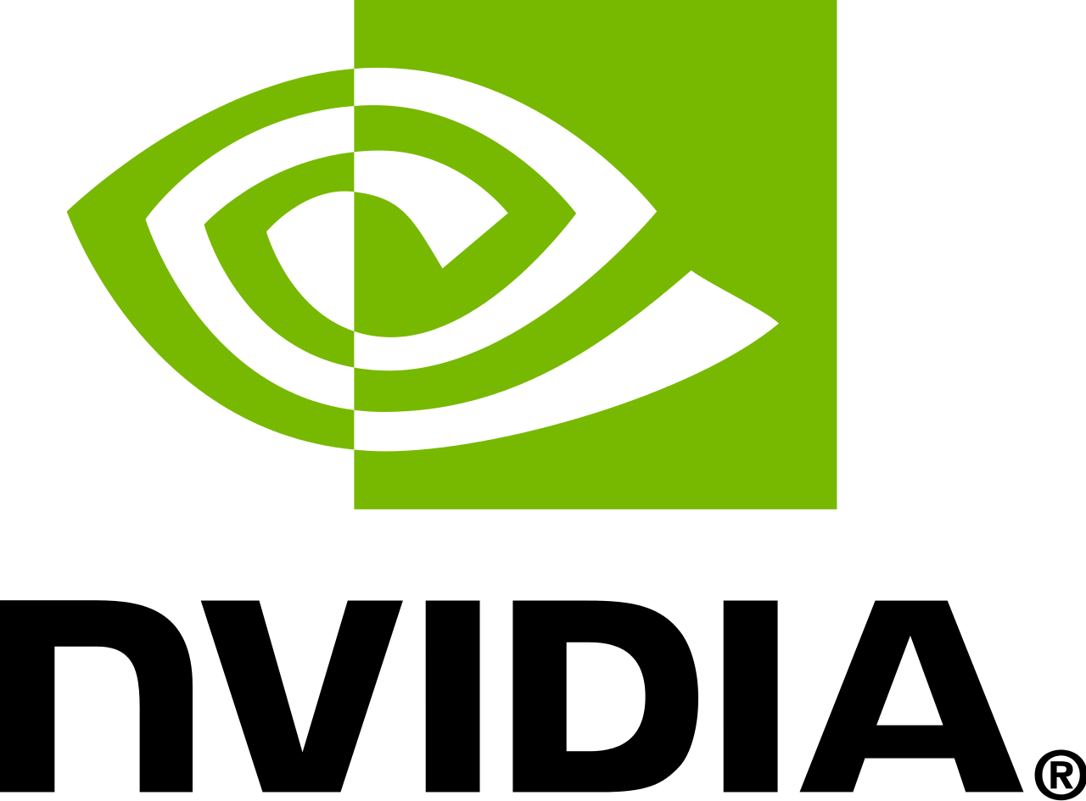

Single-Board Computer (SBC) Support
Extending AI Capabilities with Meadow.Linux
Notes:
Meadow isn't limited to microcontrollers; it also supports hardware across multiple platforms.
In addition to the Meadow F7 MCU, Meadow supports:
Single-Board Computers (SBCs): like the Raspberry Pi, BeagleBone, and NVIDIA Jetson Nano.
Desktop Machines: via Meadow.Linux.
Choosing hardware often balances power consumption and compute power. The Meadow F7 can run on battery power, making it ideal for low-energy applications. If you need more performance, you can move up to a Raspberry Pi Zero, BeagleBone, or the powerful Jetson Nano.
This flexibility lets you select the right hardware for your edge AI project.

Slide 16
Preparing a model for LiteRT
From Cloud to Microcontroller
Train
Convert
Prepare
Deploy
Infer
Notes:
Let's take a moment to understand the high-level workflow for training and deploying a machine learning model to a microcontroller.
Train the Model with Full TensorFlow:
We begin by training our machine learning model using the full version of TensorFlow on a computer or server.
This step involves feeding the model with training data, adjusting its parameters, and validating its performance until it meets our requirements.
Convert the Model to TensorFlow Lite Format:
Once the model is trained, we convert it into a TensorFlow Lite (TFLite) flat buffer file.
This conversion optimizes the model for size and efficiency, making it suitable for deployment on devices with limited resources.
Prepare the Model for Microcontrollers:
The .tflite file works with regular TensorFlow Lite, but to use it on a microcontroller, we need to convert it into an array in our programming language of choice (e.g., C#, C++).
This involves embedding the model data directly into our application's code, typically as a byte array or an include file.
Deploy and Perform Inference on the Microcontroller:
We then deploy the model to our microcontroller, such as the Meadow F7.
On the device, we can perform inference using the model, allowing it to make predictions or decisions based on new input data from sensors or other sources.
Summary:
Train → Convert → Prepare → Deploy and Infer
This workflow enables us to leverage sophisticated machine learning models on microcontrollers, bringing advanced AI capabilities to edge devices with limited computational resources.
A basic workflow is to train a model using full tensorflow on a computer or server then convert that model to a tensorflowlite flat buffer file
This .tflite file works with regular tensorflow lite but you’ll need to convert it to an array in your language of choice to use on micro controllers
We can then perform inference with our model on our microcontroller

Slide 17
Resources
www.wildernesslabs.co
github.com/wildernesslabs/meadow.foundation
Wilderness Labs Website
Meadow.Foundation source code
github.com/wildernesslabs/meadow.tensorflow
ai.google.dev/edge/litert
TensorFlow LiteRT library for the Meadow F7
TensorFlow LiteRT documentation
Notes:
Before we conclude, I'd like to point you toward some resources that can help you continue your journey with AI at the edge.
Meadow Documentation: Comprehensive guides and API references to get you started with Meadow and .NET.
TensorFlow Lite Resources: Tutorials and documentation for building and deploying TensorFlow Lite models.
Useful Sensors: Information on their AI sensors and how to integrate them into your projects.
Edge Impulse: Explore their platform for training and deploying machine learning models for edge devices.
Community Forums: Join the Meadow and .NET communities to connect with other developers, ask questions, and share your experiences.
Links to these resources are provided on this slide.
Thank you once again for attending this session. I hope you found it informative and inspiring. I'm excited to see how you'll apply these technologies to create innovative edge AI solutions.
Have a great day!

Slide 18
Thank you
Notes:
As we wrap up today's session, I'd like to recap the key points we've discussed.
AI at the edge is becoming increasingly important for efficient, low-latency IoT applications.
Meadow F7 and .NET provide a powerful platform for developing edge AI solutions, combining robust hardware with a familiar development environment.
TensorFlow’s LiteRT enables us to run optimized machine learning models on resource-constrained devices.
Useful Sensors offer plug-and-play AI functionalities that simplify adding advanced capabilities to projects.
Meadow.Foundation and Meadow.Linux extend the platform's capabilities across various devices, supporting a unified development experience.
Future integrations with platforms like Edge Impulse will further enhance our ability to develop and deploy AI models.
I encourage you to explore these tools and consider how you can leverage AI at the edge in your own projects. The possibilities are vast, and the technology is more accessible than ever.
Thank you for your attention, and I look forward to seeing what you create with Meadow and .NET.

